Slide 1
Governance and Compliance

Slide 2
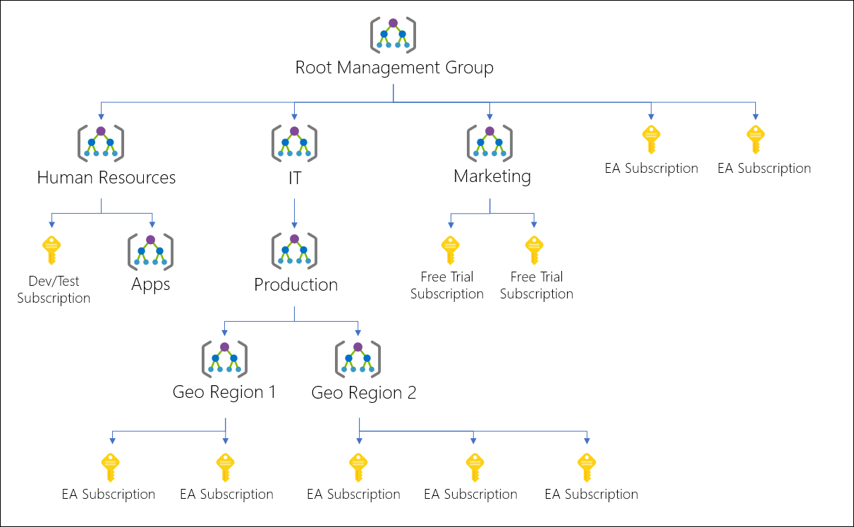
Management Groups
Management Group provides a level of scope above subscriptions.
Organizational alignment for azure subscriptions through custom hierarchies and grouping

Slide 3
Azure Subscriptions
Azure Subscription is a logical unit of Azure services that is linked to an Azure account for billing
Users, Groups and Service Principal
Azure Resources in Resource Group
Authentication
Authorization
Azure Active Directory
Azure Subscriptions

Slide 4
Getting a Subscription
Enterprise Agreements
Resellers
Partners
Personal
Pay-As-You-Go
Free Trial
Student Subscription
Azure Pass

Slide 5
Resource Limit

Slide 6
Resource Tags
Apply tags to logically organize them by categories
Name and Value Pair Ex: name as Environment and value as Production
Retrieve all resources in the subscription and group billing data
Tags applied to resource groups will not be inherited by the resources in that resource group

Slide 7
Tagging Examples
Environment
Department
Location
Application Name
Cost Center
Owner
Maintenance Window
Data Classification

Slide 8
Cost Analysis
Get the overall utilization of Azure resources
Actual Spend
Forecast Spend

Slide 9
Pricing Calculator
Provides estimates in all areas of Azure, including compute, networking, storage, web and databases.

Slide 10
Azure Policy

Slide 11
Azure Policy
A service in Azure that you can use to create, assign and mange policies.
Policies helps you enforce rules over you resources.

Slide 12
Advantages
Enforcement and Compliance
Apply Policies at Scale

Slide 13


Implementing Azure Policy
Browse Policy Definitions
Create Initiative Definitions
Scope the Initiative Definition
View Policy Evaluation results

Slide 14
Role Based Access Control

Slide 15
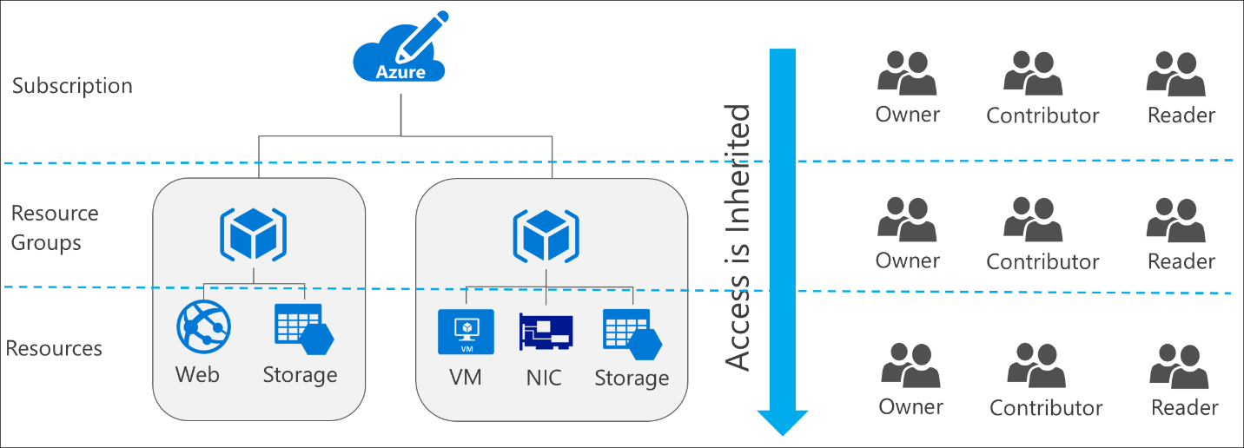









RBAC
Managing access to resources in Azure
Capability to grant appropriate access to Azure AD Users, Groups and Services.

Slide 16
Roles
Owner – Manage everything including access
Contributor – Manager everything except access
Reader – View everything but cannot make changes

